Slide 1
Treasury research
A decentralized quant trading platform

Slide 2
Put your quant strategy on blockchain
To get closer to data and trading desk
On-chain DATA
As blockchain activity booming, variety of on-chain data generate significant alpha opportunity for professional traders to exploit.
→ Put your strategy on blockchain to get instant access to on-chain data.
Decentralized TRADING DESK
There is a fasting-growing number of on-chain trading portals, such as DEXs, aggregators and derivatives, etc. Always
→ Put your strategy on blockchain to get connected with variety of on-chain trading portals.

Slide 3
What stop de-quants
to put their strategies on DEFis trading?
Hard to access & index on-chain signals (on multi-chains) seamlessly.
Indexing & querying
Multi-chains aggregation
hard to implement & execute trading strategies in a trustworthy manner.
Trusted execution environment
Accessibility to trading portals on multi-chains
Lacking of mechanism to allow de-quants to monetize their strategies.
Not development-friendly for algorithm engineers.
Always great to reward best strategies higher fund leverage !

Slide 4
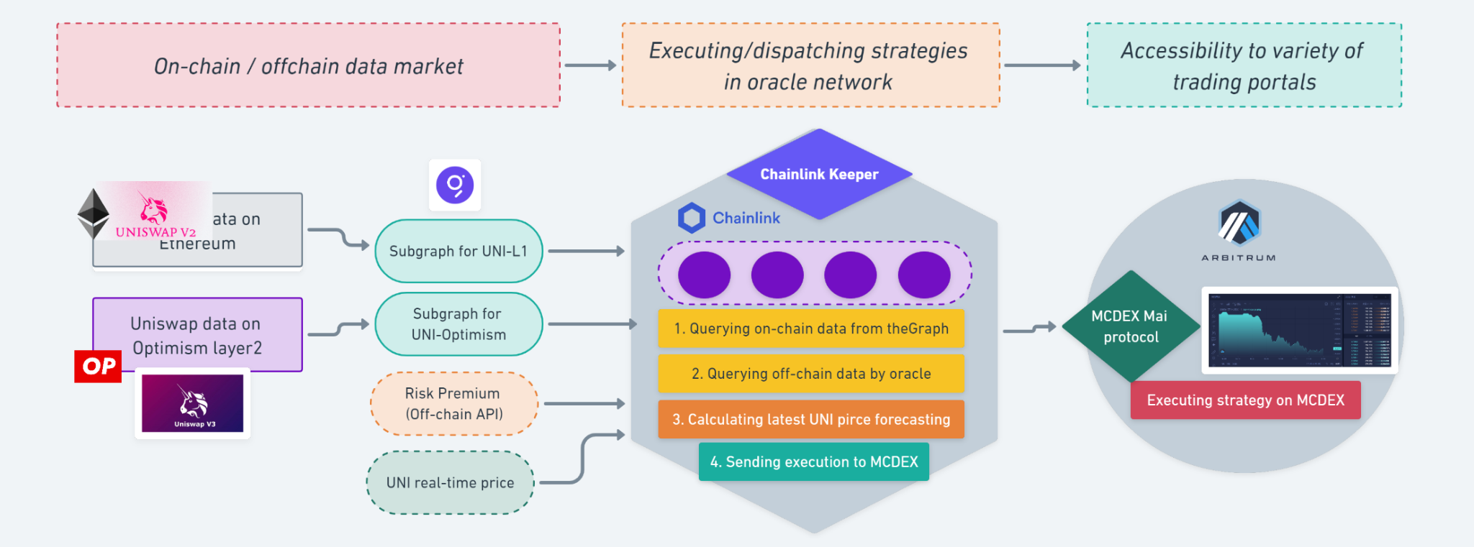
Solution
Treasury research de-quant platform

Slide 5
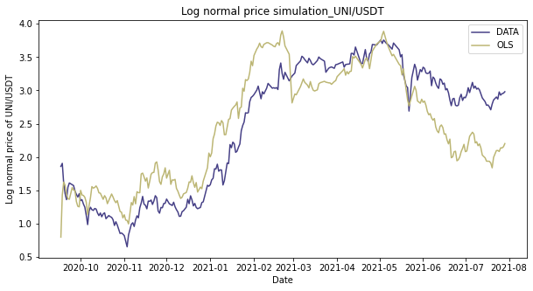
Hackathon implementation
How to build a simple linear regression algo. On TR de-quant
What is the correlation between
UNI’s TVL, daily MV trading Vol.
→ UNI’s price?

Slide 6
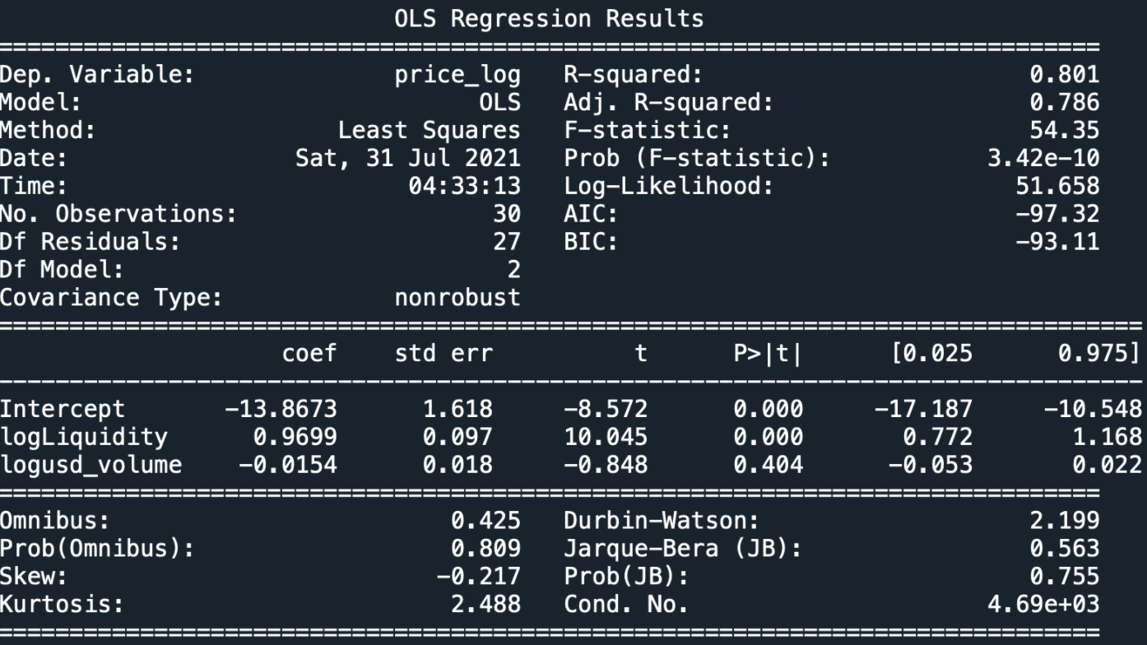
Hackathon implementation
Modeling & backtest
Simulation results is not that good, but let’s implement this strategy in TR de-Quant platform anyway.

Slide 7
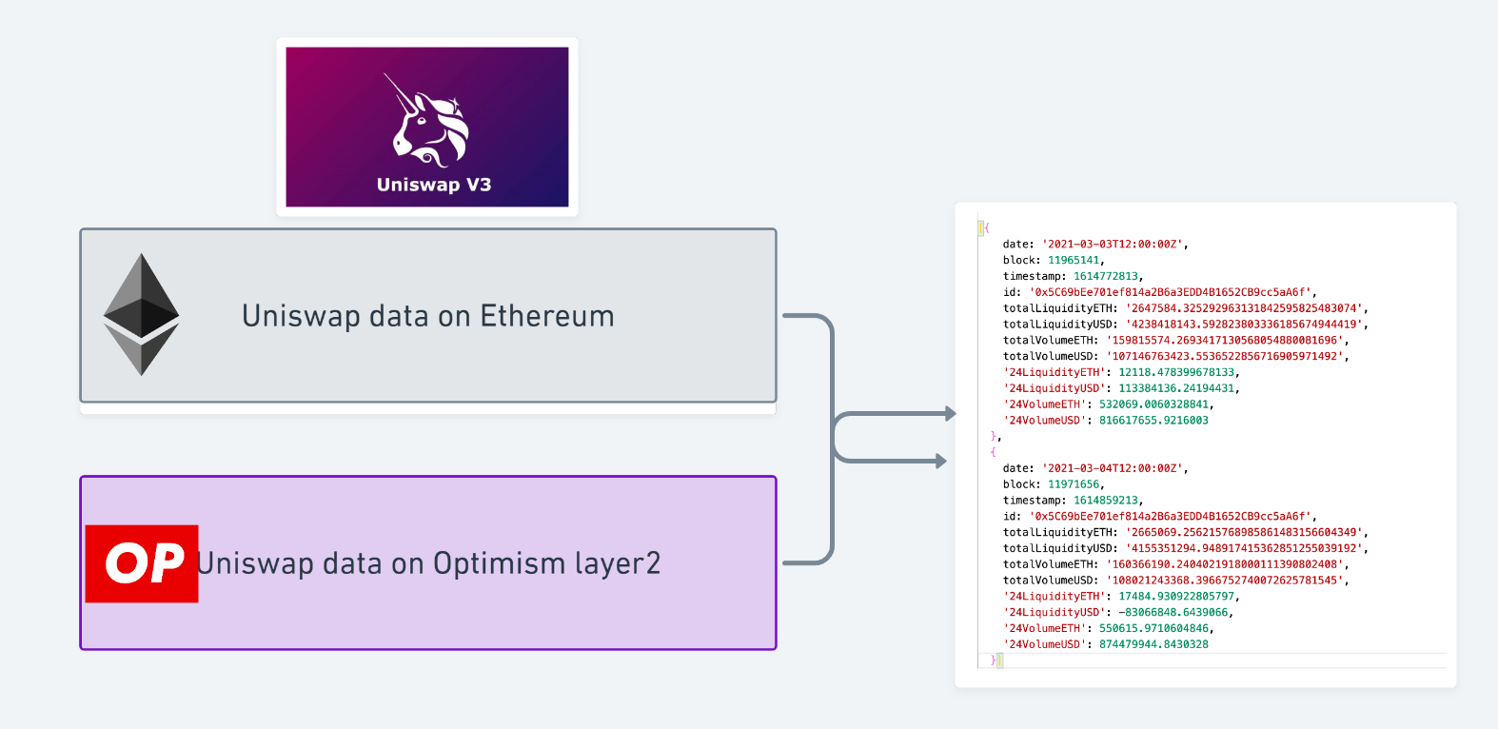
Hackathon implementation
II. Signals collecting and consolidation
Querying UNI’s real-time indexed TVL and MV trading vol. from both Ethereum L1 & Optimism.
Consolidating them into global values.

Slide 8
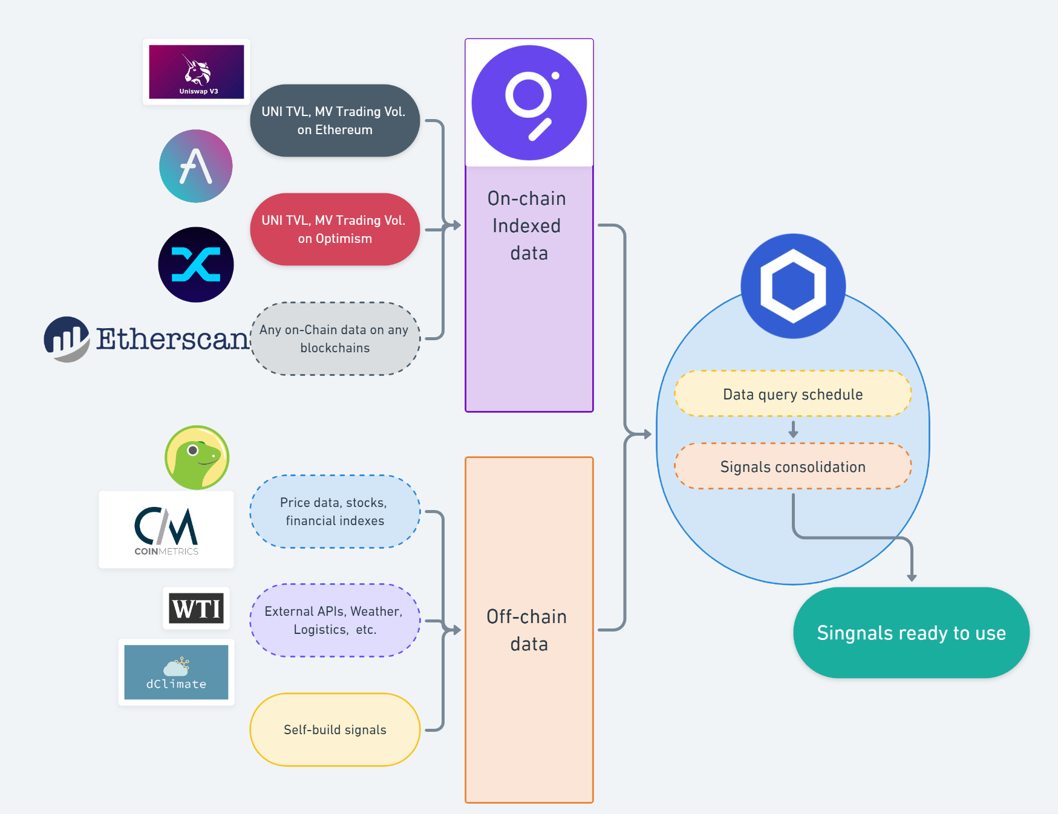
TR De-quant platform
A decentralized financial data market
With empowering of theGraph and Chainlink, we can build a decentralized financial data market
→ de-quants can use it to cook their own on-chain strategies.

Slide 9

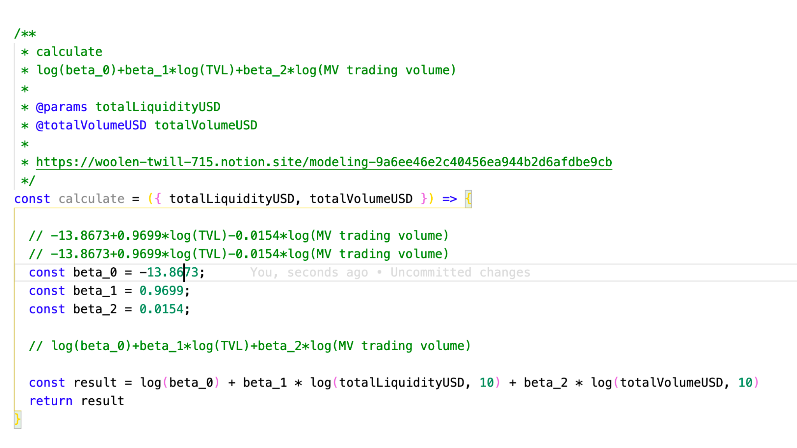
Hackathon implementation
III. strategy implementation
/contract/theGraphDataEA.sol

Slide 10
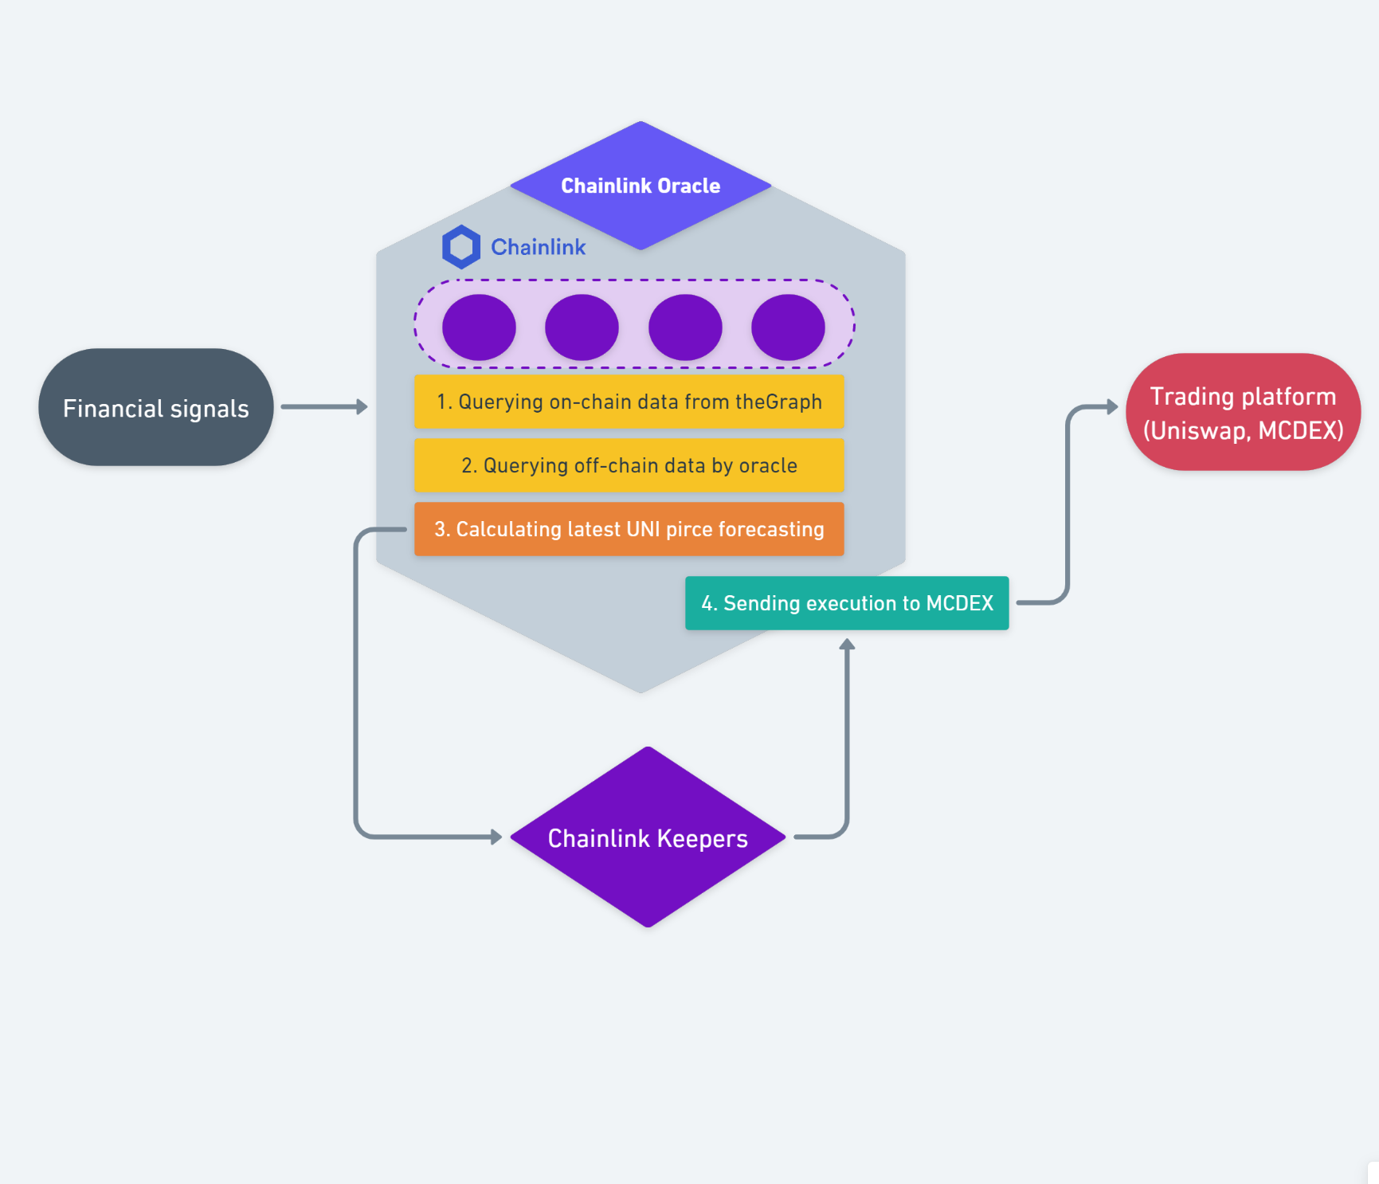
TR De-quant platform
A off-chain computation environment
With empowering of Chainlink off-chain computation and task scheduler
→ de-quants can implement their strategy into oracle to master its data flow and execution.

Slide 11
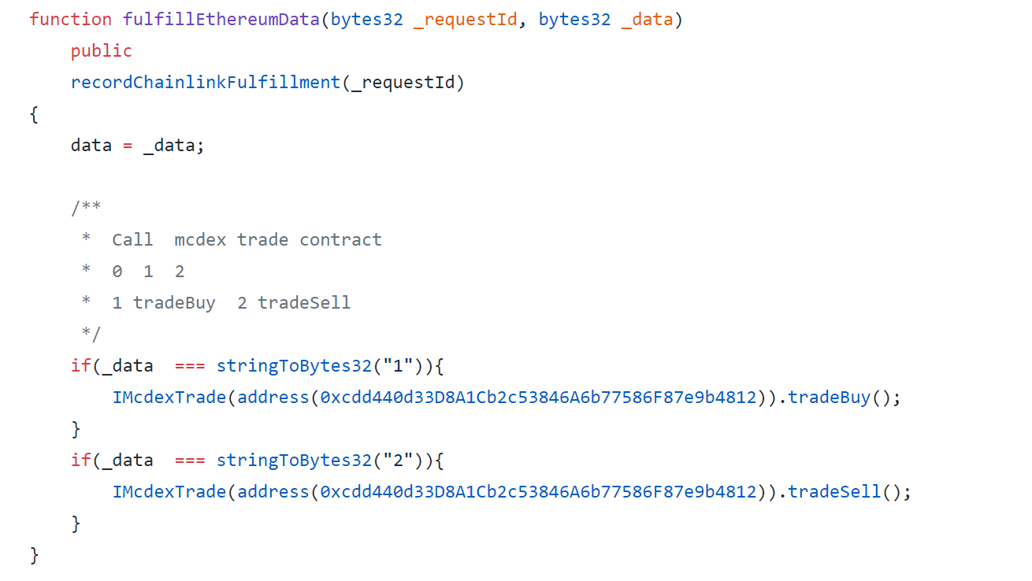
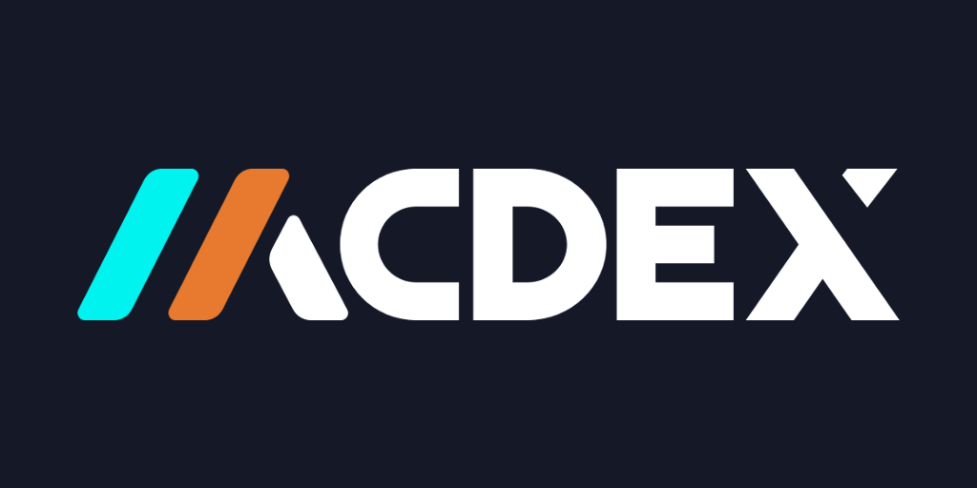
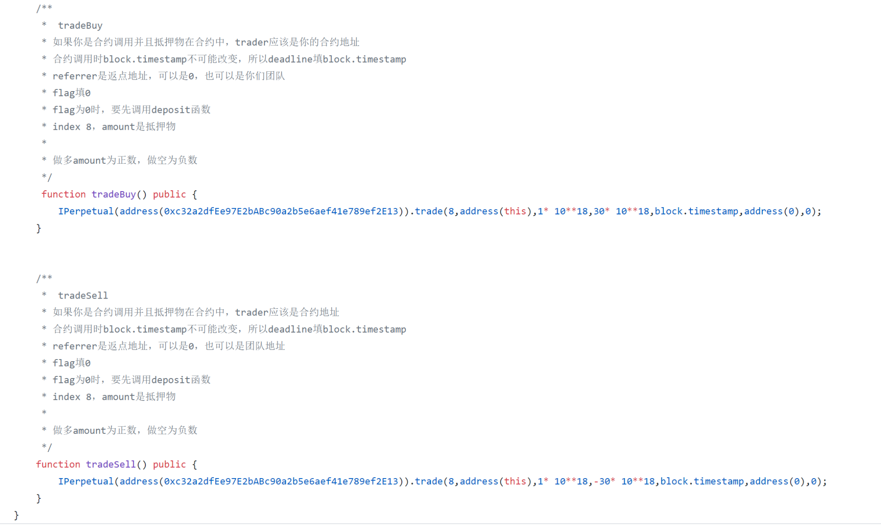
Hackathon implementation
iV. Execution fulfillment
/contract/theGraphDataEA.sol
IF predict price > current price
→ Buy in / keep buy position
ELSE
→ Sell out / keep empty position
/contract/mcdex-mai/mcdex..sol

Slide 12
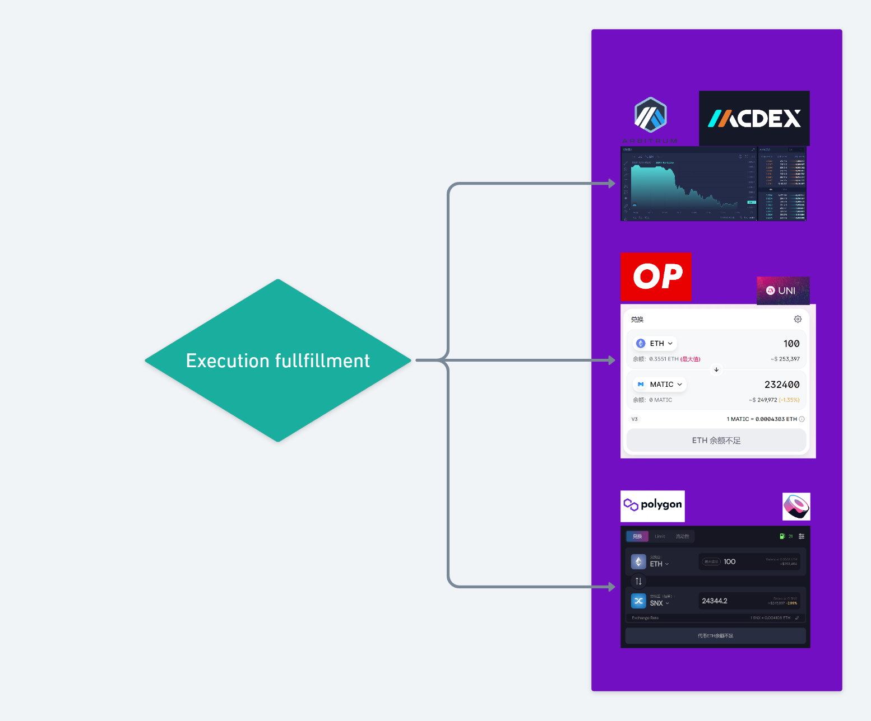
TR De-quant platform
A de-quants trading portals hub
With empowering of on-chain trading derivatives / DEXs like MCDEX
→ de-quants can access to the best liquidity seamlessly with no development cost.

Slide 13
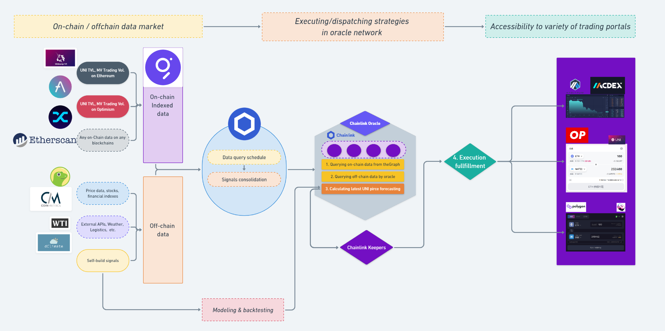
Whole picture

Slide 14


Slide 15
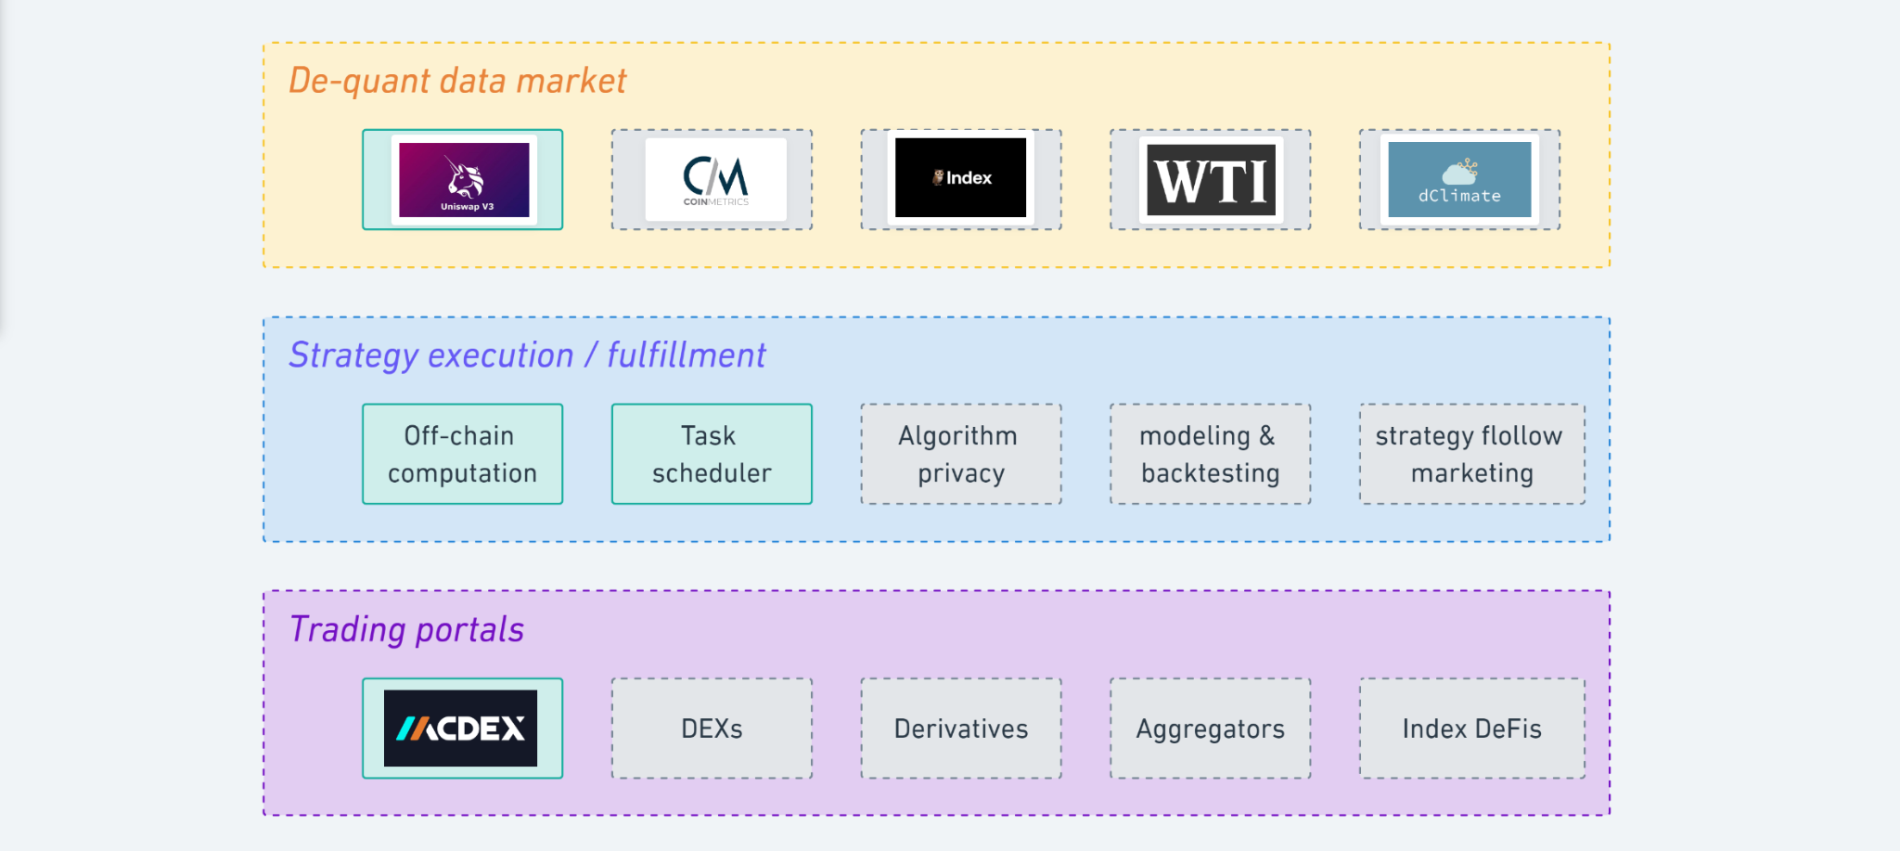
Extensibility

Slide 16
Team infos
Team#16: Treasury research (de-quant platform)
Yu Wenqing - Team leader & product manager
previously worked for BTCChina and Fundamental labs, He is also worked for Chainlink as a Developer advocate and solution architect.
Wei Yang - Smart contract developer
previously worked for multiple internet startups, Wei has strong development experience on Python, Node.js, and Solidity.
Harry Hong - Data engineering
previously worked for Web3 foundation and multiple blockchain startups, Harry has plenty of blockchain technology experience, he is also a crypto enthusiast.
Jamie Cheng - Solution architect
previously worked for BTCChina, Jamie also found a blockchain startup in 2018, he also worked for some famous blockchain projects as architect and technology advisors.
Ms. X - Financial product manager
Ms. X requires to stay anonymous, she worked for a topped crypto corporate institution as a research analyst, she has strong capability in financial data analysis and solid experience on on-chain DeFi data analysis.

Slide 17
Other info & reference
Tech spec:
https://docs.google.com/document/d/1lXZnjveEo0auYCogztoEqjKRZnxsyqEQE9CaevpH6O4/edit?usp=sharing
Pitch deck: https://docs.google.com/presentation/d/1dK8rBgWmJkh5w2fzypOWWTOcGu6gPXXzElGZZADZFxw/edit?usp=sharing
GitHub: https://github.com/Treasury-research/TR-theGraph-Chainlink-EA
Twitter handle: https://twitter.com/wenqingyu
Email: yuwenqingisu@gmail.com

Slide 18
Reference
theGraph explorer
https://thegraph.com/explorer
theGraph Uniswap V3 Official
https://thegraph.com/explorer/subgraph?id=0x9bde7bf4d5b13ef94373ced7c8ee0be59735a298-2&version=0x9bde7bf4d5b13ef94373ced7c8ee0be59735a298-2-0&view=Playground
Dune Analytics - UNI borrow interest rate on AAVE
https://duneanalytics.com/queries/93593
Dune Analytics - Price in UNI
https://duneanalytics.com/queries/93645
Dune Analytics - Uniswap Ethereum vs. Optimism comparison
https://duneanalytics.com/msilb7/Uniswap-v3-Ethereum-vs-Optimism
Arbitrum Developer Page
https://developer.offchainlabs.com/docs/public_testnet
MCDEX technical documents
https://github.com/mcdexio
Test trading page: UNI-USD on Arbitrum Rinkeby
https://app.mcdex.io/trade/00009
MCDEX Perpetual-interface document
https://github.com/mcdexio/documents/blob/master/en/perpetual-interfaces.md
LINK token contract list
https://docs.chain.link/docs/link-token-contracts/
Faucet website
https://linkfaucet.protofire.io/rinkebyarbitrum

